Slide 1

Cashel Community School
Subject Choice
1st Year

Slide 2

Recipe for Good Decisions
Step 1: Research - Gathering information
Step 2: Discuss
Step 3: Reflect
Step 4: Make a decision

Slide 3
What do I need to Know?
1. Compulsory exam subjects – taken by everybody
2. Compulsory non exam subjects – taken by everybody
3. Optional subjects- subjects that you select - students study Four Optional Subjects

Slide 4
Very Important to note
Students will be asked to select six subjects in order of preference when completing their form.

Slide 5
Compulsory Exam Subjects
Maths
English
Irish
History
Science
Compulsory non-exam Subjects
SPHE
CSPE Wellbeing
PE
Religious Education
Optional Subjects
French Music Geography Business Studies Woodwork
German Art Home Economics Metalwork Technical Graphics

Slide 6
Subjects taken at higher or ordinary level include:
Maths
English
Irish
All other exam subjects are taken at common level
Classroom Based Assessments (CBA)
Students do CBA’s in all subjects for Junior Certificate. There will be a CBA in Second Year and one in Third Year.

Slide 7
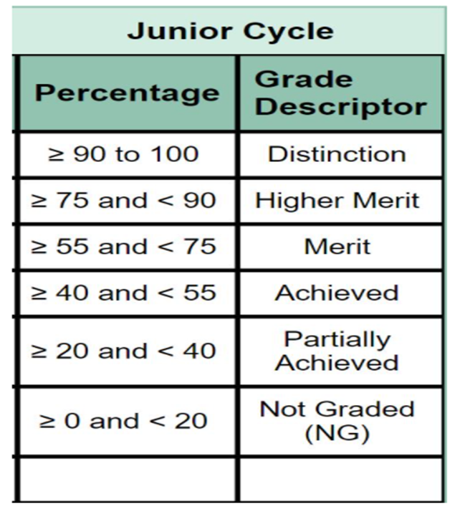
Junior Cycle Grading
The Junior Cycle CBA grades are as follows:
Exceptional
Above expectations
In line with expectations
Yet to meet expectations
Not reported

Slide 8


Step 1: Research
Key Places where information can be found
  Websites such as www.careersportal.ie and www.qualifax.ie
  Careers Portal website can be used to find out about the content of Junior Cert subjects.
There is some key information that you need to be aware of.
Two of the key areas to consider
  Science – Core 2025/26
  Languages – French/German – optional ?

Slide 9
Third Language
French
German
This is an area that could have a long term consequence
Why?
It’s essential for entry into most universities – UCC, University of Galway, UCD, Maynooth University, the Royal College of Surgeons, N.C.A.D.
To study areas such as:
Arts (e.g. English, History, Philosophy)
Law
Social Science
Medicine
Health Science
Commerce/Business
Human Sciences
Benefits of a Language
Experience a new culture
Global careers
Multinational magnet
More opportunities
www.languagesconnect.ie - website

Slide 10






If you want to study the following areas below in the Universities listed, then you require a language
A Doctor
A Pharmacist
A Physiotherapist
Dentistry
Study the Law
Commerce/Business
Accountancy
Social Science
Arts Degree
FRENCH / GERMAN

Slide 11
Third Language
Some students don’t keep on a language
Why?
This is often because they have language or specific learning difficulties
Some students have been granted an exemption from languages
This exemption covers them for their third level entry requirement
It’s fair to say that languages don’t suit everybody.
Some students know that they are more interested in other areas such as science, engineering or practical areas
There are always other options
161 Courses require a 3rd Language • HOWEVER OVER 1300+ COURSE DO NOT REQUIRE A LANGUAGE

Slide 12
Third Language not required
No Third Language Required (NUI’s) for
Engineering, Science or Food Science Degrees
Always check as exceptions do occur
No Third Language required for Nursing
No Third Language required for Business or Law at Maynooth University provided you are not studying a language as part of your degree

Slide 13
Further Options without a language
Students will still have access to:
1. Entry into all Institutes of Technology such as TUS, MTU, SETU, TU Dublin etc
2. Entry into the University of Limerick and Trinity College Dublin where they require a language other than English which may be Irish. Dublin City University where they require English or Irish.
3. Apprenticeships
4. To complete a one year full time post-leaving cert course in a college of further education. This will in turn allow them to apply for courses where they would have needed a third language. Limited courses available and doesn’t include the medical or para-medical areas. (Other Pathway)

Slide 14










Slide 15
After Junior Cert Science divides into four:
A Science subject is necessary for over 200+ courses
Required for entry into
Medicine
Veterinary
Dentistry
Pharmacy
Dietetics
•2 Science subjects are essential for some courses
Chemistry
Physics
Science
Biology
Agricultural Science
It is strongly advised that students would have taken science at Junior Cert if they wish to take at L.C.
OVER 1342 COURSE DO NOT REQUIRE SCIENCE

Slide 16
Generally speaking
Science and Engineering courses do not require a Language
Medical/ Health Science/ Para Medical courses will require a language and maybe up to two science subjects depending on the course
A practical subject such as Engineering, Design & Communication Graphics or Construction Studies may be accepted instead of a Science subject for some Engineering degree courses

Slide 17
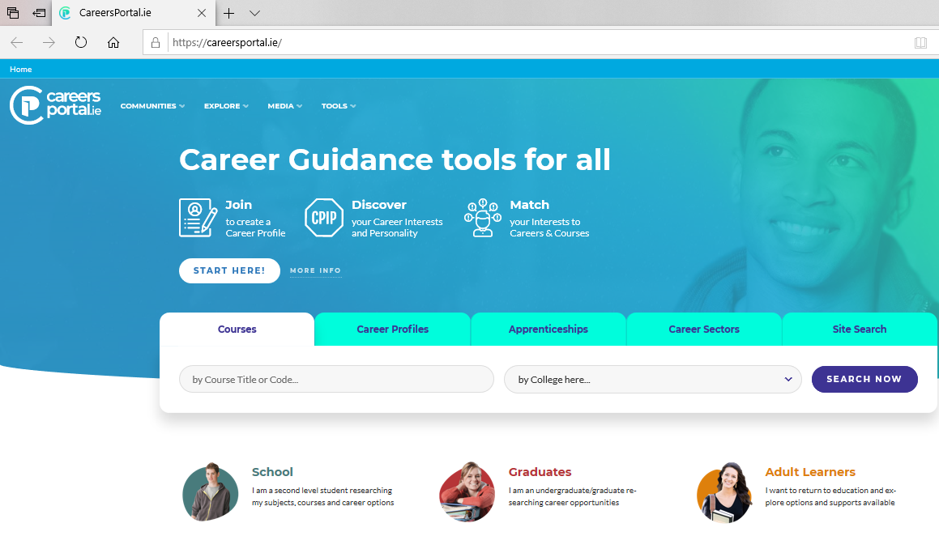



Research: Finding Helpful Information. Follow the hyperlinks
Careers Portal
Junior Cert
Qualifax
Qualifax Subject Choice
NCCA

Slide 18

Step 2: Discuss
Having a talk at home with Parents/Guardians & older siblings
Feedback from1st Year Parent Teacher meeting
Consult Reports & Results
Course content:
What student liked, enjoyed, found easy/hard
Practical/Hands-on subject or learning off
What skills are required e.g. playing an instrument/singing, artistic, good with hands
Question or Clarifications – contact Guidance Counsellor

Slide 19

Step 3: Reflect
Do I like this subject?
Am I good at it?
How have I performed up to now?
Is there a chance I might need it for further study/career?
Am I keeping my options open?
I want to be …
Make an independent decision.

Slide 20

Implications of choosing/not choosing a subject
Qualifax - Subject requirement tool
www.qualiax.ie
Students
Useful Tools
Minimum Subject Requirement
Junior Certificate Subjects
Scroll down for questions

Slide 21
Decide
We do not have a crystal ball to see into the consequences of our decisions but we tend to be happier and more at ease with our decisions when we have done our work!

Slide 22

Choosing Subjects because your friends are doing them
Choosing Subjects based on older siblings experience
Choosing Subjects because you like the teacher
Common Errors
Reputation of subject- it’s easy/hard
Gender – Girls/Boys don’t do – very limiting and not true

Slide 23

Making your selection:
Be sure that you write down you choices in order of preference. 1-6
Number One being the subject that you want to the most and so on.

Slide 24
Considerations
Subjects That you are Good At
Subjects You
Most Enjoy
Subjects You Might Need at Third Level
Aptitude and Interest
Seek Advice –
Guidance Counsellor

Slide 25
